Slide 1

Introduction to Hypertext Markup Language

Slide 2
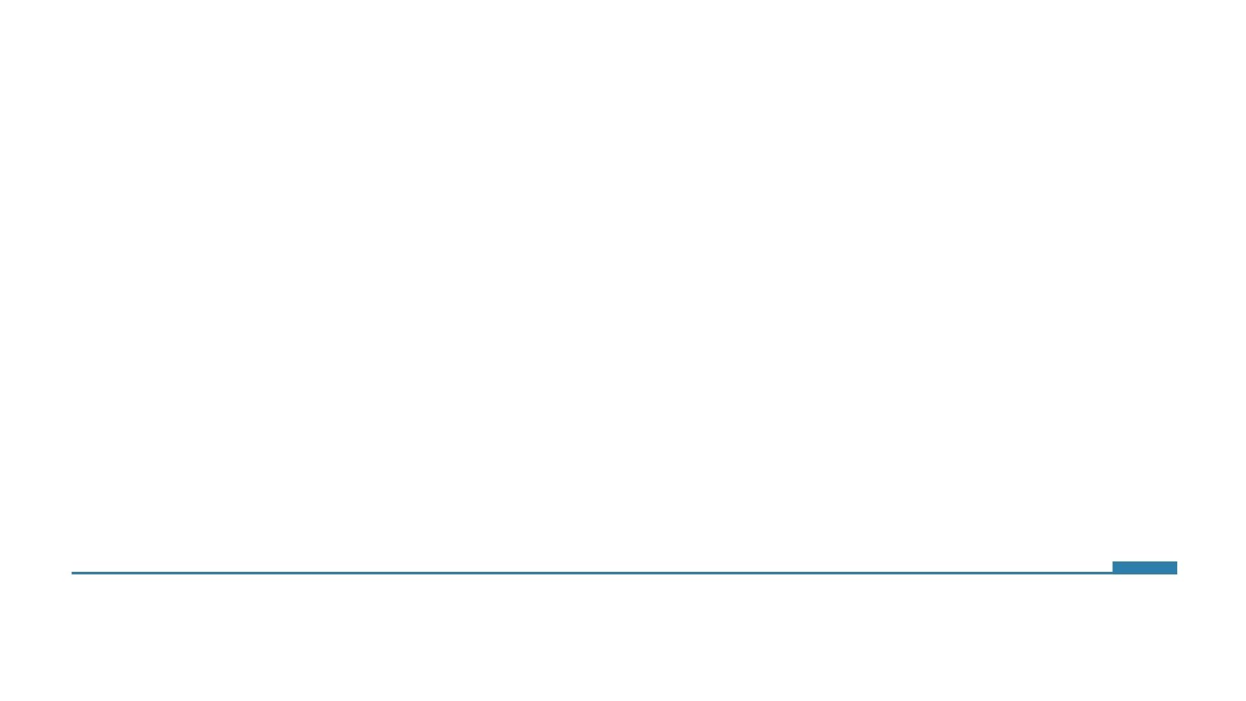
Internet is an electronic communication network that connects devices across the globe

Slide 3

World Wide Web (WWW) is an interconnected system of public webpages that can be accessed through the internet
Tim Berners-Lee
Inventor of WWW

Slide 4
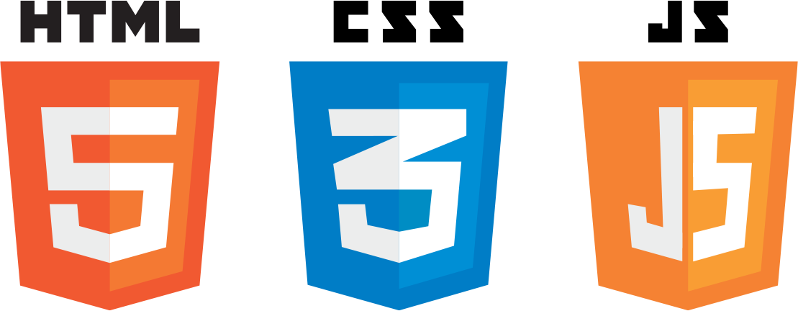
Websites usually last forever due to the legacy features that are available in the three languages

Slide 5

HTML stands for Hypertext Markup Language
Used in websites and applications
Framework on which a website is built.

Slide 6
Acts as a markup to bridge the gap between Humans and Computers
Easy to understand
Acts as a set of instructions about how to display content on a web application

Slide 7
Features
Declarative language
Simple structure
Self identifies some small errors
Various Functionality offered

Slide 8
HTML Element

Slide 9
An HTML element is a type of HTML document component. HTML document is composed of a tree of simple HTML nodes, such as text nodes, and HTML elements, which add semantics and formatting to parts of document.

Slide 10
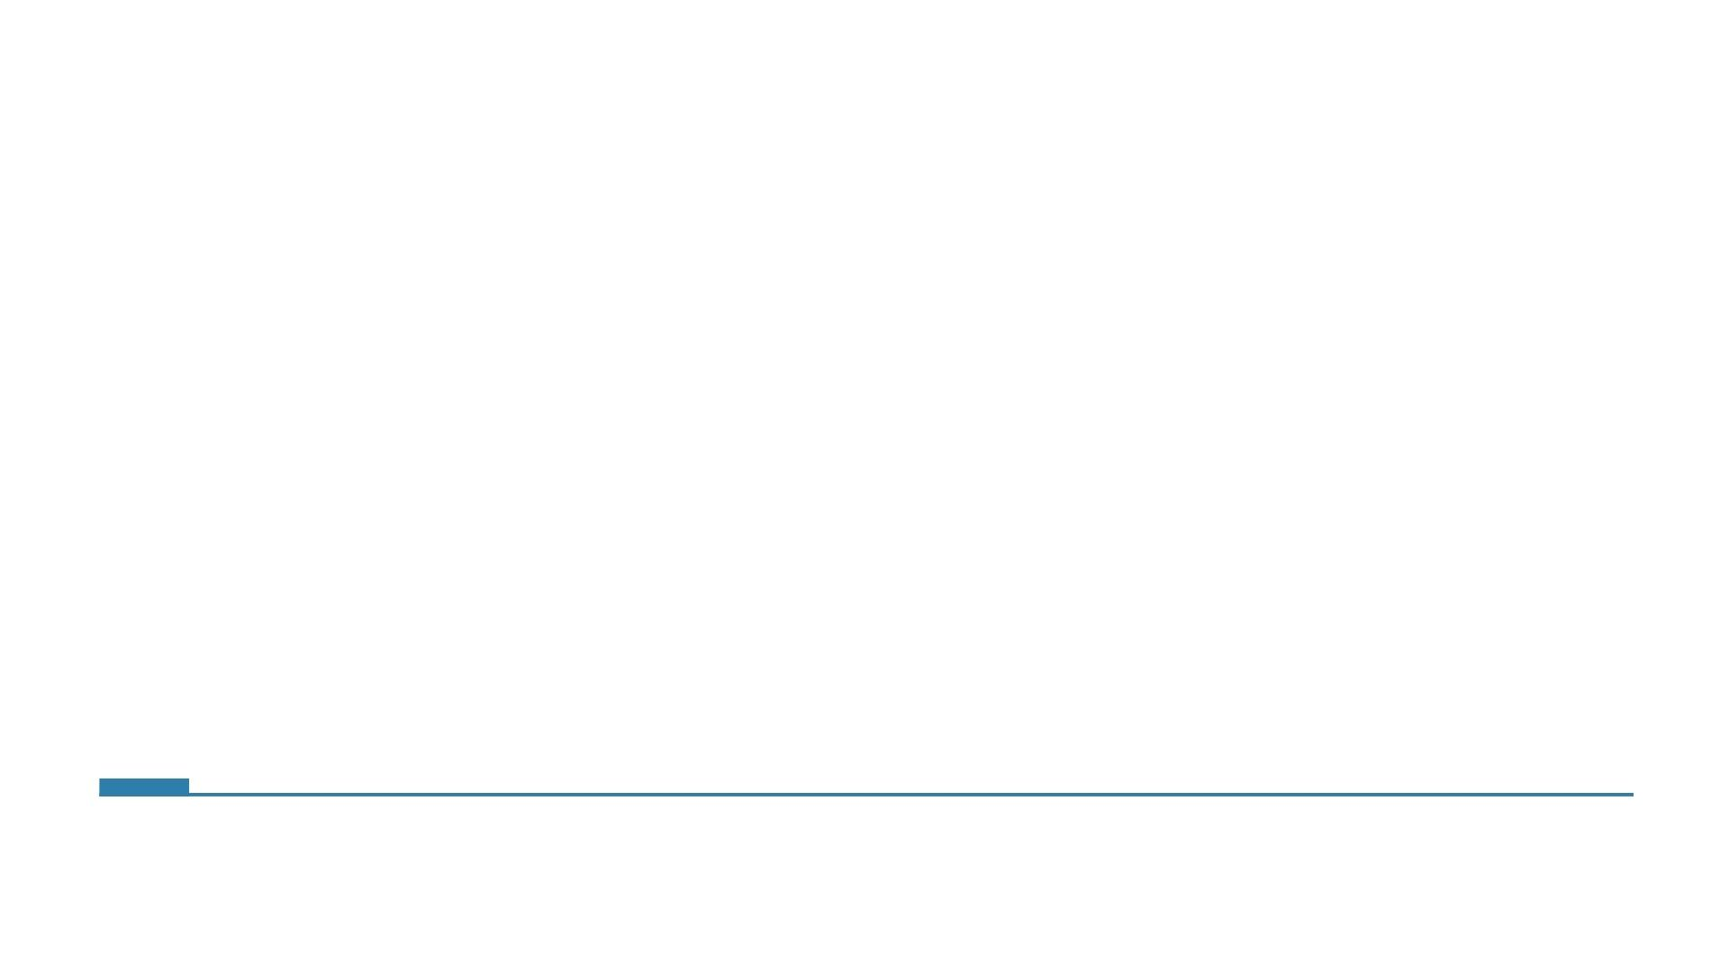

HTML Tag
< p >
Name of Element

Slide 11
<p> Hello World </p>
Opening Tag
Closing Tag

Slide 12
Parent
Child
<div>
<p> Hello World </p>
</div>

Slide 13
HTML Document

Slide 14
<!DOCTYPE html>
<html>
<head>
<title> Introduction </title>
</head>
<body>
</body>
</html>

Slide 15
<!DOCTYPE html>
<html>
<head>
<title> Introduction </title>
</head>
<body>
</body>
</html>

Slide 16
<!DOCTYPE html>
<html>
<head>
<title> Introduction </title>
</head>
<body>
</body>
</html>

Slide 17
<!DOCTYPE html>
<html>
<head>
<title> Introduction </title>
</head>
<body>
</body>
</html>

Slide 18
<!DOCTYPE html>
<html>
<head>
<title> Introduction </title>
</head>
<body>
</body>
</html>

Slide 19
<!DOCTYPE html>
<html>
<head>
<title> Introduction </title>
</head>
<body>
</body>
</html>

Slide 20
Heading

Slide 21
Headings are the title that you put on an HTML page in order to break up sections on a page.
<h1> Welcome </h1>

Slide 22
Paragraph

Slide 23
Paragraphs are used to write a body of text on an HTML page
<p> This is some text </p>

Slide 24
List

Slide 25
The lists tag is used to create lists on an HTML page.
There are two main types of list on HTML, the ordered list and the unordered list.
Unordered List: <ul> tag
Ordered list: <ol> tag
List Item: <li> tag.

Slide 26
Styling Text Elements

Slide 27
HTML Text Elements can be styled nesting specific HTML elements within them
Bold Text: <b> tag
Italic Text: <i> tag
Underline Text: <u> tag.

Slide 28
Some HTML Elements already have inbuilt text style in them so the tags are not included in those cases:
Headings are Bold on default
Links are Underlined on default

Slide 29
Div

Slide 30
Division or container elements separate the html page into different sections.
<div>
<p> Hello World </p>
</div>

Slide 31
HTML Attributes

Slide 32
An attribute is content that is added to the opening tag of an HTML element and can be used to add features to the element.
<div id=“number-list”>
Name
Value

Slide 33
Global Attributes
Id
Class
Style
Title

Slide 34
Image

Slide 35
Image element is used to add an image to the page
<img src=“google.com/heading.png” width=“300px” height=“200px” />

Slide 36
Image element is used to add an image to the page
Source of the Image
<img src=“google.com/heading.png” width=“300px” height=“200px” />

Slide 37
Image element is used to add an image to the page
<img src=“google.com/heading.png” width=“300px” height=“200px” />
Width of Image
Height of Image

